Slide 1
Implementation
Techniques
Software Architecture
Lecture 16

Slide 2
Objectives
Concepts
  Implementation as a mapping problem
  Architecture implementation frameworks
  Evaluating frameworks
  Relationships between middleware, frameworks, component models
  Building new frameworks
  Concurrency and generative technologies
  Ensuring architecture-to-implementation consistency
Examples
  Different frameworks for pipe-and-filter
  Different frameworks for the C2 style
Application
  Implementing Lunar Lander in different frameworks

Slide 3
Objectives
Concepts
  Implementation as a mapping problem
  Architecture implementation frameworks
  Evaluating frameworks
  Relationships between middleware, frameworks, component models
  Building new frameworks
  Concurrency and generative technologies
  Ensuring architecture-to-implementation consistency
Examples
  Different frameworks for pipe-and-filter
  Different frameworks for the C2 style
Application
  Implementing Lunar Lander in different frameworks

Slide 4

Recall Pipe-and-Filter
Components (‘filters’) organized linearly, communicate through character-stream ‘pipes,’ which are the connectors
Filters may run concurrently on partial data
In general, all input comes in through the left and all output exits from the right
Software Architecture: Foundations, Theory, and Practice; Richard N. Taylor, Nenad Medvidovic, and Eric M. Dashofy; (C) 2008 John Wiley & Sons, Inc. Reprinted with permission.

Slide 5
Framework #1: stdio
Standard I/O framework used in C programming language
Each process is a filter
  Reads input from standard input (aka ‘stdin’)
  Writes output to standard output (aka ‘stdout’)
    Also a third, unbuffered output stream called standard error (‘stderr’) not considered here
  Low and high level operations
    getchar(…), putchar(…) move one character at a time
    printf(…) and scanf(…) move and format entire strings
  Different implementations may vary in details (buffering strategy, etc.)

Slide 6
Evaluating stdio
Platform support
  Available with most, if not all, implementations of C programming language
  Operates somewhat differently on OSes with no concurrency (e.g., MS-DOS)
Fidelity
  Good support for developing P&F applications, but no restriction that apps have to use this style
Matching assumptions
  Filters are processes and pipes are implicit. In-process P&F applications might require modifications
Efficiency
  Whether filters make maximal use of concurrency is partially up to filter implementations and partially up to the OS

Slide 7
Framework #2: java.io
Standard I/O framework used in Java language
Object-oriented
Can be used for in-process or inter-process P&F applications
  All stream classes derive from InputStream or OutputStream
  Distinguished objects (System.in and System.out) for writing to process’ standard streams
  Additional capabilities (formatting, buffering) provided by creating composite streams (e.g., a Formatting-Buffered-InputStream)

Slide 8
Evaluating java.io
Matching assumptions
  Easy to construct intra- and inter-process P&F applications
  Concurrency can be an issue; many calls are blocking
Efficiency
  Users have fine-grained control over, e.g., buffering
  Very high efficiency mechanisms (memory mapped I/O, channels) not available (but are in java.nio)
Platform support
  Available with all Java implementations on many platforms
  Platform-specific differences abstracted away
Fidelity
  Good support for developing P&F applications, but no restriction that apps have to use this style

Slide 9
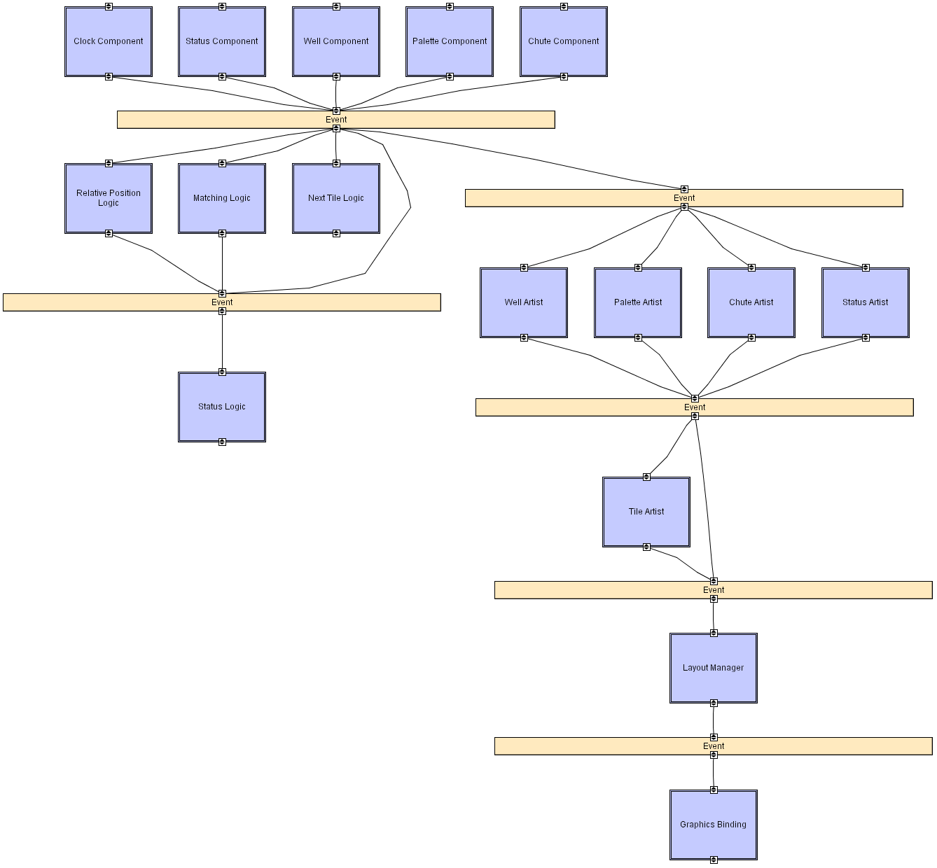
Recall the C2 Style
Layered style
with event-based
communication
over two-way
broadcast
buses
Strict rules on
concurrency,
dependencies,
and so on
Many frameworks developed for
different languages; focus on two
alternative Java frameworks here
Software Architecture: Foundations, Theory, and Practice; Richard N. Taylor, Nenad Medvidovic, and Eric M. Dashofy; (C) 2008 John Wiley & Sons, Inc. Reprinted with permission.

Slide 10
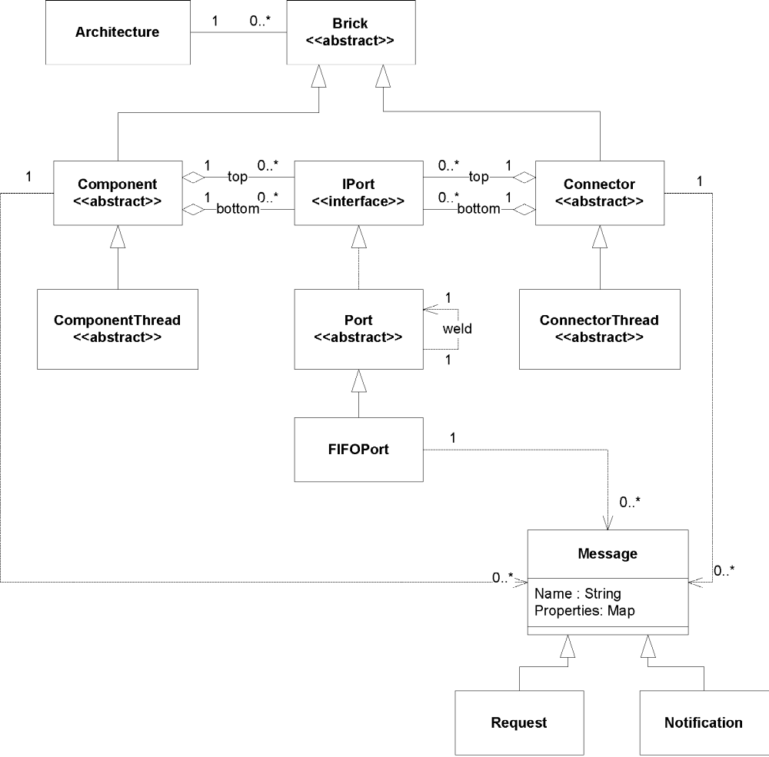
Framework #1: Lightweight C2 Framework
16 classes, 3000
lines of code
Components & connectors extend abstract base classes
Concurrency, queuing handled at individual comp/conn level
Messages are request or notification objects
Software Architecture: Foundations, Theory, and Practice; Richard N. Taylor, Nenad Medvidovic, and Eric M. Dashofy; (C) 2008 John Wiley & Sons, Inc. Reprinted with permission.

Slide 11
Evaluating Lightweight C2 Framework
Matching assumptions
  Comp/conn main classes must inherit from distinguished base classes
  All messages must be in dictionary form
Efficiency
  Lightweight framework; efficiency may depend on threading and queuing policy implemented by individual elements
Platform support
  Available with all Java implementations on many platforms
Fidelity
  Assists developers with many aspects of C2 but does not enforce these constraints
  Leaves threading and queuing policies up to individual elements

Slide 12
Framework #2: Flexible C2 Framework
73 classes, 8500
lines of code
Uses interfaces
rather than base
classes
Threading policy
for application
is pluggable
Message queuing policy is
also pluggable
Software Architecture: Foundations, Theory, and Practice; Richard N. Taylor, Nenad Medvidovic, and Eric M. Dashofy; (C) 2008 John Wiley & Sons, Inc. Reprinted with permission.

Slide 13
Framework #2: Flexible C2 Framework
Software Architecture: Foundations, Theory, and Practice; Richard N. Taylor, Nenad Medvidovic, and Eric M. Dashofy; (C) 2008 John Wiley & Sons, Inc. Reprinted with permission.

Slide 14
Evaluating Flexible C2 Framework
Platform support
  Available with all Java implementations on many platforms
Fidelity
  Assists developers with many aspects of C2 but does not enforce these constraints
  Provides several alternative application-wide threading and queuing policies
Matching assumptions
  Comp/conn main classes must implement distinguished interfaces
  Messages can be any serializable object
Efficiency
  User can easily swap out and tune threading and queuing policies without disturbing remainder of application code

Slide 15
Objectives
Concepts
  Implementation as a mapping problem
  Architecture implementation frameworks
  Evaluating frameworks
  Relationships between middleware, frameworks, component models
  Building new frameworks
  Concurrency and generative technologies
  Ensuring architecture-to-implementation consistency
Examples
  Different frameworks for pipe-and-filter
  Different frameworks for the C2 style
Application
  Implementing Lunar Lander in different frameworks

Slide 16
Implementing Pipe and Filter Lunar Lander
Framework: java.io
Implementing as a multi-process application
  Each component (filter) will be a separate OS process
  Operating system will provide the pipe connectors
Going to use just the standard input and output streams
  Ignoring standard error
Ignoring good error handling practices and corner cases for simplicity
Software Architecture: Foundations, Theory, and Practice; Richard N. Taylor, Nenad Medvidovic, and Eric M. Dashofy; (C) 2008 John Wiley & Sons, Inc. Reprinted with permission.

Slide 17
Implementing Pipe and Filter Lunar Lander
A note on I/O:
  Some messages sent from components are intended for output to the console (to be read by the user)
    These messages must be passed all the way through the pipeline and output at the end
    We will preface these with a ‘#’
  Some messages are control messages meant to communicate state to a component down the pipeline
    These messages are intercepted by a component and processed
    We will preface these with a ‘%’
Software Architecture: Foundations, Theory, and Practice; Richard N. Taylor, Nenad Medvidovic, and Eric M. Dashofy; (C) 2008 John Wiley & Sons, Inc. Reprinted with permission.

Slide 18
Implementing Pipe and Filter Lunar Lander
First: GetBurnRate component
  Loops; on each loop:
    Prompt user for new burn rate
    Read burn rate from the user on standard input
    Send burn rate to next component
    Quit if burn rate read < 0
Software Architecture: Foundations, Theory, and Practice; Richard N. Taylor, Nenad Medvidovic, and Eric M. Dashofy; (C) 2008 John Wiley & Sons, Inc. Reprinted with permission.

Slide 19
GetBurnRate Filter
//Import the java.io framework
import java.io.*;
public class GetBurnRate{
public static void main(String[] args){
//Send welcome message
System.out.println("#Welcome to Lunar Lander");
try{
//Begin reading from System input
BufferedReader inputReader =
new BufferedReader(new InputStreamReader(System.in));
//Set initial burn rate to 0
int burnRate = 0;
do{
//Prompt user
System.out.println("#Enter burn rate or <0 to quit:");
. . .
Software Architecture: Foundations, Theory, and Practice; Richard N. Taylor, Nenad Medvidovic, and Eric M. Dashofy; (C) 2008 John Wiley & Sons, Inc. Reprinted with permission.

Slide 20
GetBurnRate Filter
//Import the java.io framework
import java.io.*;
public class GetBurnRate{
public static void main(String[] args){
//Send welcome message
System.out.println("#Welcome to Lunar Lander");
try{
//Begin reading from System input
BufferedReader inputReader =
new BufferedReader(new InputStreamReader(System.in));
//Set initial burn rate to 0
int burnRate = 0;
do{
//Prompt user
System.out.println("#Enter burn rate or <0 to quit:");
. . .
. . .
//Read user response
try{
String burnRateString = inputReader.readLine();
burnRate = Integer.parseInt(burnRateString);
//Send user-supplied burn rate to next filter
System.out.println("%" + burnRate);
}
catch(NumberFormatException nfe){
System.out.println("#Invalid burn rate.");
}
}while(burnRate >= 0);
inputReader.close();
}
catch(IOException ioe){
ioe.printStackTrace();
}
}
}
Software Architecture: Foundations, Theory, and Practice; Richard N. Taylor, Nenad Medvidovic, and Eric M. Dashofy; (C) 2008 John Wiley & Sons, Inc. Reprinted with permission.

Slide 21
Implementing Pipe and Filter Lunar Lander
Second: CalcNewValues Component
  Read burn rate from standard input
  Calculate new game state including game-over
  Send new game state to next component
    New game state is not sent in a formatted string; that’s the display component’s job
Software Architecture: Foundations, Theory, and Practice; Richard N. Taylor, Nenad Medvidovic, and Eric M. Dashofy; (C) 2008 John Wiley & Sons, Inc. Reprinted with permission.

Slide 22
CalcBurnRate Filter
import java.io.*;
public class CalcNewValues{
public static void main(String[] args){
//Initialize values
final int GRAVITY = 2;
int altitude = 1000;
int fuel = 500;
int velocity = 70;
int time = 0;
try{
BufferedReader inputReader = new
BufferedReader(new InputStreamReader(System.in));
//Print initial values
System.out.println("%a" + altitude);
System.out.println("%f" + fuel);
System.out.println("%v" + velocity);
System.out.println("%t" + time);
. . .
Software Architecture: Foundations, Theory, and Practice; Richard N. Taylor, Nenad Medvidovic, and Eric M. Dashofy; (C) 2008 John Wiley & Sons, Inc. Reprinted with permission.

Slide 23
CalcBurnRate Filter
import java.io.*;
public class CalcNewValues{
public static void main(String[] args){
//Initialize values
final int GRAVITY = 2;
int altitude = 1000;
int fuel = 500;
int velocity = 70;
int time = 0;
try{
BufferedReader inputReader = new
BufferedReader(new InputStreamReader(System.in));
//Print initial values
System.out.println("%a" + altitude);
System.out.println("%f" + fuel);
System.out.println("%v" + velocity);
System.out.println("%t" + time);
. . .
String inputLine = null;
do{
inputLine = inputReader.readLine();
if((inputLine != null) &&
(inputLine.length() > 0)){
if(inputLine.startsWith("#")){
//This is a status line of text, and
//should be passed down the pipeline
System.out.println(inputLine);
}
else if(inputLine.startsWith("%")){
//This is an input burn rate
try{
int burnRate = Integer.parseInt(inputLine.substring(1));
if(altitude <= 0){
System.out.println("#The game is over.");
}
else if(burnRate > fuel){
System.out.println("#Sorry, you don't" +
"have that much fuel.");
}
. . .
Software Architecture: Foundations, Theory, and Practice; Richard N. Taylor, Nenad Medvidovic, and Eric M. Dashofy; (C) 2008 John Wiley & Sons, Inc. Reprinted with permission.

Slide 24
CalcBurnRate Filter
else{
//Calculate new application state
time = time + 1;
altitude = altitude - velocity;
velocity = ((velocity + GRAVITY) * 10 -
burnRate * 2) / 10;
fuel = fuel - burnRate;
if(altitude <= 0){
altitude = 0;
if(velocity <= 5){
System.out.println("#You have landed safely.");
}
else{
System.out.println("#You have crashed.");
}
}
}
//Print new values
System.out.println("%a" + altitude);
System.out.println("%f" + fuel);
System.out.println("%v" + velocity);
System.out.println("%t" + time);
}
catch(NumberFormatException nfe){
}
. . .
import java.io.*;
public class CalcNewValues{
public static void main(String[] args){
//Initialize values
final int GRAVITY = 2;
int altitude = 1000;
int fuel = 500;
int velocity = 70;
int time = 0;
try{
BufferedReader inputReader = new
BufferedReader(new InputStreamReader(System.in));
//Print initial values
System.out.println("%a" + altitude);
System.out.println("%f" + fuel);
System.out.println("%v" + velocity);
System.out.println("%t" + time);
. . .
String inputLine = null;
do{
inputLine = inputReader.readLine();
if((inputLine != null) &&
(inputLine.length() > 0)){
if(inputLine.startsWith("#")){
//This is a status line of text, and
//should be passed down the pipeline
System.out.println(inputLine);
}
else if(inputLine.startsWith("%")){
//This is an input burn rate
try{
int burnRate = Integer.parseInt(inputLine.substring(1));
if(altitude <= 0){
System.out.println("#The game is over.");
}
else if(burnRate > fuel){
System.out.println("#Sorry, you don't" +
"have that much fuel.");
}
. . .
Software Architecture: Foundations, Theory, and Practice; Richard N. Taylor, Nenad Medvidovic, and Eric M. Dashofy; (C) 2008 John Wiley & Sons, Inc. Reprinted with permission.

Slide 25
CalcBurnRate Filter
else{
//Calculate new application state
time = time + 1;
altitude = altitude - velocity;
velocity = ((velocity + GRAVITY) * 10 -
burnRate * 2) / 10;
fuel = fuel - burnRate;
if(altitude <= 0){
altitude = 0;
if(velocity <= 5){
System.out.println("#You have landed safely.");
}
else{
System.out.println("#You have crashed.");
}
}
}
//Print new values
System.out.println("%a" + altitude);
System.out.println("%f" + fuel);
System.out.println("%v" + velocity);
System.out.println("%t" + time);
}
catch(NumberFormatException nfe){
}
. . .
import java.io.*;
public class CalcNewValues{
public static void main(String[] args){
//Initialize values
final int GRAVITY = 2;
int altitude = 1000;
int fuel = 500;
int velocity = 70;
int time = 0;
try{
BufferedReader inputReader = new
BufferedReader(new InputStreamReader(System.in));
//Print initial values
System.out.println("%a" + altitude);
System.out.println("%f" + fuel);
System.out.println("%v" + velocity);
System.out.println("%t" + time);
. . .
String inputLine = null;
do{
inputLine = inputReader.readLine();
if((inputLine != null) &&
(inputLine.length() > 0)){
if(inputLine.startsWith("#")){
//This is a status line of text, and
//should be passed down the pipeline
System.out.println(inputLine);
}
else if(inputLine.startsWith("%")){
//This is an input burn rate
try{
int burnRate = Integer.parseInt(inputLine.substring(1));
if(altitude <= 0){
System.out.println("#The game is over.");
}
else if(burnRate > fuel){
System.out.println("#Sorry, you don't" +
"have that much fuel.");
}
. . .
}
}
}while((inputLine != null) && (altitude > 0));
inputReader.close();
}
catch(IOException ioe){
ioe.printStackTrace();
}
}
}
Software Architecture: Foundations, Theory, and Practice; Richard N. Taylor, Nenad Medvidovic, and Eric M. Dashofy; (C) 2008 John Wiley & Sons, Inc. Reprinted with permission.

Slide 26
Implementing Pipe and Filter Lunar Lander
Third: DisplayValues component
  Read value updates from standard input
  Format them for human reading and send them to standard output
Software Architecture: Foundations, Theory, and Practice; Richard N. Taylor, Nenad Medvidovic, and Eric M. Dashofy; (C) 2008 John Wiley & Sons, Inc. Reprinted with permission.

Slide 27
DisplayValues Filter
import java.io.*;
public class DisplayValues{
public static void main(String[] args){
try{
BufferedReader inputReader = new
BufferedReader(new InputStreamReader(System.in));
String inputLine = null;
do{
inputLine = inputReader.readLine();
if((inputLine != null) &&
(inputLine.length() > 0)){
if(inputLine.startsWith("#")){
//This is a status line of text, and
//should be passed down the pipeline with
//the pound-sign stripped off
System.out.println(inputLine.substring(1));
}
. . .
Software Architecture: Foundations, Theory, and Practice; Richard N. Taylor, Nenad Medvidovic, and Eric M. Dashofy; (C) 2008 John Wiley & Sons, Inc. Reprinted with permission.

Slide 28
DisplayValues Filter
else if(inputLine.startsWith("%")){
//This is a value to display
if(inputLine.length() > 1){
try{
char valueType = inputLine.charAt(1);
int value = Integer.parseInt(inputLine.substring(2));
switch(valueType){
case 'a':
System.out.println("Altitude: " + value);
break;
case 'f':
System.out.println("Fuel remaining: " + value);
break;
case 'v':
System.out.println("Current Velocity: “ + value);
break;
case 't':
System.out.println("Time elapsed: " + value);
break;
}
}
catch(NumberFormatException nfe){
}
. . .
import java.io.*;
public class DisplayValues{
public static void main(String[] args){
try{
BufferedReader inputReader = new
BufferedReader(new InputStreamReader(System.in));
String inputLine = null;
do{
inputLine = inputReader.readLine();
if((inputLine != null) &&
(inputLine.length() > 0)){
if(inputLine.startsWith("#")){
//This is a status line of text, and
//should be passed down the pipeline with
//the pound-sign stripped off
System.out.println(inputLine.substring(1));
}
. . .
Software Architecture: Foundations, Theory, and Practice; Richard N. Taylor, Nenad Medvidovic, and Eric M. Dashofy; (C) 2008 John Wiley & Sons, Inc. Reprinted with permission.

Slide 29
DisplayValues Filter
else if(inputLine.startsWith("%")){
//This is a value to display
if(inputLine.length() > 1){
try{
char valueType = inputLine.charAt(1);
int value = Integer.parseInt(inputLine.substring(2));
switch(valueType){
case 'a':
System.out.println("Altitude: " + value);
break;
case 'f':
System.out.println("Fuel remaining: " + value);
break;
case 'v':
System.out.println("Current Velocity: “ + value);
break;
case 't':
System.out.println("Time elapsed: " + value);
break;
}
}
catch(NumberFormatException nfe){
}
. . .
import java.io.*;
public class DisplayValues{
public static void main(String[] args){
try{
BufferedReader inputReader = new
BufferedReader(new InputStreamReader(System.in));
String inputLine = null;
do{
inputLine = inputReader.readLine();
if((inputLine != null) &&
(inputLine.length() > 0)){
if(inputLine.startsWith("#")){
//This is a status line of text, and
//should be passed down the pipeline with
//the pound-sign stripped off
System.out.println(inputLine.substring(1));
}
. . .
}
}
}
}while(inputLine != null);
inputReader.close();
}
catch(IOException ioe){
ioe.printStackTrace();
}
}
}
Software Architecture: Foundations, Theory, and Practice; Richard N. Taylor, Nenad Medvidovic, and Eric M. Dashofy; (C) 2008 John Wiley & Sons, Inc. Reprinted with permission.

Slide 30
Implementing Pipe and Filter Lunar Lander
Instantiating the application
  java GetBurnRate | java CalcNewValues | java DisplayValues
Software Architecture: Foundations, Theory, and Practice; Richard N. Taylor, Nenad Medvidovic, and Eric M. Dashofy; (C) 2008 John Wiley & Sons, Inc. Reprinted with permission.

Slide 31
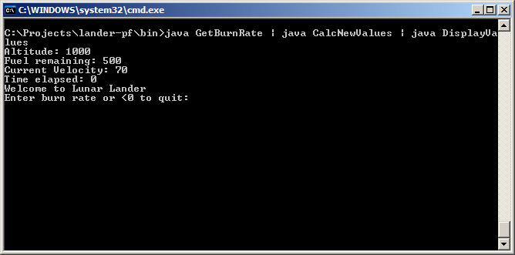
Implementing Pipe and Filter Lunar Lander
Software Architecture: Foundations, Theory, and Practice; Richard N. Taylor, Nenad Medvidovic, and Eric M. Dashofy; (C) 2008 John Wiley & Sons, Inc. Reprinted with permission.

Slide 32
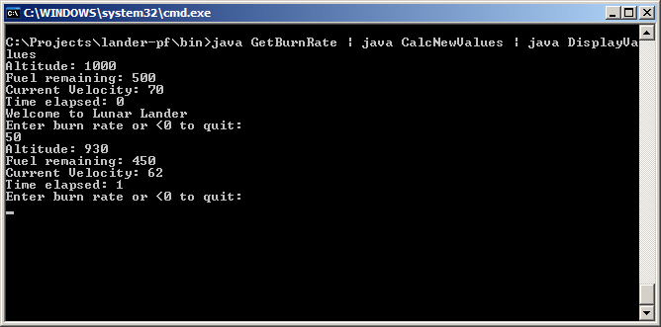
Implementing Pipe and Filter Lunar Lander

Slide 33
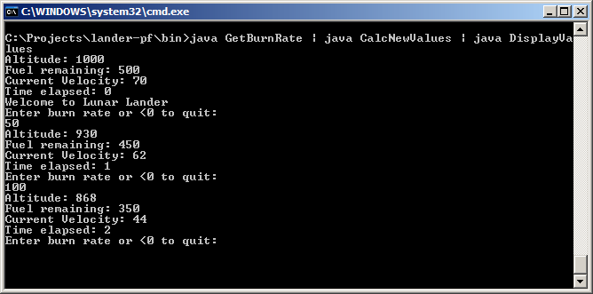
Implementing Pipe and Filter Lunar Lander
Software Architecture: Foundations, Theory, and Practice; Richard N. Taylor, Nenad Medvidovic, and Eric M. Dashofy; (C) 2008 John Wiley & Sons, Inc. Reprinted with permission.

Slide 34
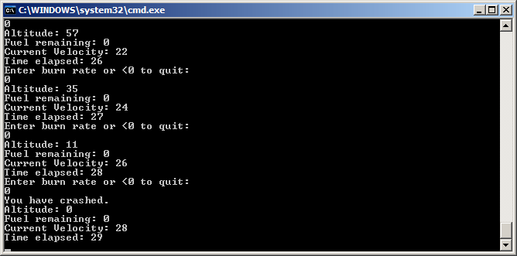
Implementing Pipe and Filter Lunar Lander

Slide 35
Takeaways
java.io provides a number of useful facilities
  Stream objects (System.in, System.out)
  Buffering wrappers
OS provides some of the facilities
  Pipes
  Concurrency support
    Note that this version of the application would not work if it operated in batch-sequential mode
We had other communication mechanisms available, but did not use them to conform to the P&F style
We had to develop a new (albeit simple) protocol to get the correct behavior

Slide 36
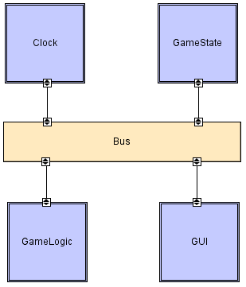
Implementing Lunar Lander in C2
Framework: Lightweight
C2 framework
Each component has its
own thread of control
Components receive
requests or notifications
and respond with new
ones
Message routing follows
C2 rules
This is a real-time, clock-driven version of Lunar Lander
Software Architecture: Foundations, Theory, and Practice; Richard N. Taylor, Nenad Medvidovic, and Eric M. Dashofy; (C) 2008 John Wiley & Sons, Inc. Reprinted with permission.

Slide 37
Implementing Lunar Lander in C2 (cont’d)
First: Clock component
Sends out a ‘tick’ notification
periodically
Does not respond to any
messages
Software Architecture: Foundations, Theory, and Practice; Richard N. Taylor, Nenad Medvidovic, and Eric M. Dashofy; (C) 2008 John Wiley & Sons, Inc. Reprinted with permission.

Slide 38
Clock Component
import c2.framework.*;
public class Clock extends ComponentThread{
public Clock(){
super.create("clock", FIFOPort.class);
}
public void start(){
super.start();
Thread clockThread = new Thread(){
public void run(){
//Repeat while the application runs
while(true){
//Wait for five seconds
try{
Thread.sleep(5000);
}
catch(InterruptedException ie){}
//Send out a tick notification
Notification n = new Notification("clockTick");
send(n);
}
}
};
Software Architecture: Foundations, Theory, and Practice; Richard N. Taylor, Nenad Medvidovic, and Eric M. Dashofy; (C) 2008 John Wiley & Sons, Inc. Reprinted with permission.

Slide 39
Clock Component
import c2.framework.*;
public class Clock extends ComponentThread{
public Clock(){
super.create("clock", FIFOPort.class);
}
public void start(){
super.start();
Thread clockThread = new Thread(){
public void run(){
//Repeat while the application runs
while(true){
//Wait for five seconds
try{
Thread.sleep(5000);
}
catch(InterruptedException ie){}
//Send out a tick notification
Notification n = new Notification("clockTick");
send(n);
}
}
};
clockThread.start();
}
protected void handle(Notification n){
//This component does not handle notifications
}
protected void handle(Request r){
//This component does not handle requests
}
}
Software Architecture: Foundations, Theory, and Practice; Richard N. Taylor, Nenad Medvidovic, and Eric M. Dashofy; (C) 2008 John Wiley & Sons, Inc. Reprinted with permission.

Slide 40
Implementing Lunar Lander in C2
Second: GameState
Component
Receives request to update
internal state
Emits notifications of new
game state on request
or when state changes
Does NOT compute new
state
  Just a data store
Software Architecture: Foundations, Theory, and Practice; Richard N. Taylor, Nenad Medvidovic, and Eric M. Dashofy; (C) 2008 John Wiley & Sons, Inc. Reprinted with permission.

Slide 41
GameState Component
import c2.framework.*;
public class GameState extends ComponentThread{
public GameState(){
super.create("gameState", FIFOPort.class);
}
//Internal game state and initial values
int altitude = 1000;
int fuel = 500;
int velocity = 70;
int time = 0;
int burnRate = 0;
boolean landedSafely = false;
Software Architecture: Foundations, Theory, and Practice; Richard N. Taylor, Nenad Medvidovic, and Eric M. Dashofy; (C) 2008 John Wiley & Sons, Inc. Reprinted with permission.

Slide 42
GameState Component
protected void handle(Request r){
if(r.name().equals("updateGameState")){
//Update the internal game state
if(r.hasParameter("altitude")){
this.altitude = ((Integer)r.getParameter("altitude")).intValue();
}
if(r.hasParameter("fuel")){
this.fuel = ((Integer)r.getParameter("fuel")).intValue();
}
if(r.hasParameter("velocity")){
this.velocity = ((Integer)r.getParameter("velocity")).intValue();
}
if(r.hasParameter("time")){
this.time = ((Integer)r.getParameter("time")).intValue();
}
if(r.hasParameter("burnRate")){
this.burnRate = ((Integer)r.getParameter("burnRate")).intValue();
}
if(r.hasParameter("landedSafely")){
this.landedSafely = ((Boolean)r.getParameter("landedSafely"))
.booleanValue();
}
//Send out the updated game state
Notification n = createStateNotification();
send(n);
}
import c2.framework.*;
public class GameState extends ComponentThread{
public GameState(){
super.create("gameState", FIFOPort.class);
}
//Internal game state and initial values
int altitude = 1000;
int fuel = 500;
int velocity = 70;
int time = 0;
int burnRate = 0;
boolean landedSafely = false;
Software Architecture: Foundations, Theory, and Practice; Richard N. Taylor, Nenad Medvidovic, and Eric M. Dashofy; (C) 2008 John Wiley & Sons, Inc. Reprinted with permission.

Slide 43
GameState Component
else if(r.name().equals("getGameState")){
//If a component requests the game state
//without updating it, send out the state
Notification n = createStateNotification();
send(n);
}
}
protected Notification createStateNotification(){
//Create a new notification comprising the
//current game state
Notification n = new Notification("gameState");
n.addParameter("altitude", altitude);
n.addParameter("fuel", fuel);
n.addParameter("velocity", velocity);
n.addParameter("time", time);
n.addParameter("burnRate", burnRate);
n.addParameter("landedSafely", landedSafely);
return n;
}
protected void handle(Notification n){
//This component does not handle notifications
}
}
protected void handle(Request r){
if(r.name().equals("updateGameState")){
//Update the internal game state
if(r.hasParameter("altitude")){
this.altitude = ((Integer)r.getParameter("altitude")).intValue();
}
if(r.hasParameter("fuel")){
this.fuel = ((Integer)r.getParameter("fuel")).intValue();
}
if(r.hasParameter("velocity")){
this.velocity = ((Integer)r.getParameter("velocity")).intValue();
}
if(r.hasParameter("time")){
this.time = ((Integer)r.getParameter("time")).intValue();
}
if(r.hasParameter("burnRate")){
this.burnRate = ((Integer)r.getParameter("burnRate")).intValue();
}
if(r.hasParameter("landedSafely")){
this.landedSafely = ((Boolean)r.getParameter("landedSafely"))
.booleanValue();
}
//Send out the updated game state
Notification n = createStateNotification();
send(n);
}
import c2.framework.*;
public class GameState extends ComponentThread{
public GameState(){
super.create("gameState", FIFOPort.class);
}
//Internal game state and initial values
int altitude = 1000;
int fuel = 500;
int velocity = 70;
int time = 0;
int burnRate = 0;
boolean landedSafely = false;
Software Architecture: Foundations, Theory, and Practice; Richard N. Taylor, Nenad Medvidovic, and Eric M. Dashofy; (C) 2008 John Wiley & Sons, Inc. Reprinted with permission.

Slide 44
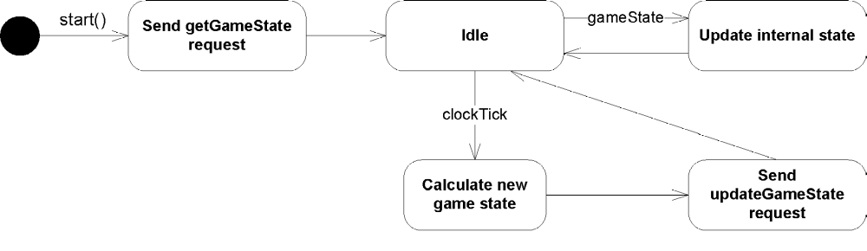
Implementing Lunar Lander in C2
Third: GameLogic
Component
Receives notifications of
game state changes
Receives clock ticks
  On clock tick notification,
  calculates new state
  and sends request up
Software Architecture: Foundations, Theory, and Practice; Richard N. Taylor, Nenad Medvidovic, and Eric M. Dashofy; (C) 2008 John Wiley & Sons, Inc. Reprinted with permission.

Slide 45
GameLogic Component
import c2.framework.*;
public class GameLogic extends ComponentThread{
public GameLogic(){
super.create("gameLogic", FIFOPort.class);
}
//Game constants
final int GRAVITY = 2;
//Internal state values for computation
int altitude = 0;
int fuel = 0;
int velocity = 0;
int time = 0;
int burnRate = 0;
public void start(){
super.start();
Request r = new Request("getGameState");
send(r);
}
Software Architecture: Foundations, Theory, and Practice; Richard N. Taylor, Nenad Medvidovic, and Eric M. Dashofy; (C) 2008 John Wiley & Sons, Inc. Reprinted with permission.

Slide 46
GameLogic Component
protected void handle(Notification n){
if(n.name().equals("gameState")){
if(n.hasParameter("altitude")){
this.altitude =
((Integer)n.getParameter("altitude")).intValue();
}
if(n.hasParameter("fuel")){
this.fuel =
((Integer)n.getParameter("fuel")).intValue();
}
if(n.hasParameter("velocity")){
this.velocity =
((Integer)n.getParameter("velocity")).intValue();
}
if(n.hasParameter("time")){
this.time =
((Integer)n.getParameter("time")).intValue();
}
if(n.hasParameter("burnRate")){
this.burnRate =
((Integer)n.getParameter("burnRate")).intValue();
}
}
import c2.framework.*;
public class GameLogic extends ComponentThread{
public GameLogic(){
super.create("gameLogic", FIFOPort.class);
}
//Game constants
final int GRAVITY = 2;
//Internal state values for computation
int altitude = 0;
int fuel = 0;
int velocity = 0;
int time = 0;
int burnRate = 0;
public void start(){
super.start();
Request r = new Request("getGameState");
send(r);
}
Software Architecture: Foundations, Theory, and Practice; Richard N. Taylor, Nenad Medvidovic, and Eric M. Dashofy; (C) 2008 John Wiley & Sons, Inc. Reprinted with permission.

Slide 47
GameLogic Component
protected void handle(Notification n){
if(n.name().equals("gameState")){
if(n.hasParameter("altitude")){
this.altitude =
((Integer)n.getParameter("altitude")).intValue();
}
if(n.hasParameter("fuel")){
this.fuel =
((Integer)n.getParameter("fuel")).intValue();
}
if(n.hasParameter("velocity")){
this.velocity =
((Integer)n.getParameter("velocity")).intValue();
}
if(n.hasParameter("time")){
this.time =
((Integer)n.getParameter("time")).intValue();
}
if(n.hasParameter("burnRate")){
this.burnRate =
((Integer)n.getParameter("burnRate")).intValue();
}
}
else if(n.name().equals("clockTick")){
//Calculate new lander state values
int actualBurnRate = burnRate;
if(actualBurnRate > fuel){
//Ensure we don’t burn more fuel than we have
actualBurnRate = fuel;
}
time = time + 1;
altitude = altitude - velocity;
velocity = ((velocity + GRAVITY) * 10 –
actualBurnRate * 2) / 10;
fuel = fuel - actualBurnRate;
//Determine if we landed (safely)
boolean landedSafely = false;
if(altitude <= 0){
altitude = 0;
if(velocity <= 5){
landedSafely = true;
}
}
import c2.framework.*;
public class GameLogic extends ComponentThread{
public GameLogic(){
super.create("gameLogic", FIFOPort.class);
}
//Game constants
final int GRAVITY = 2;
//Internal state values for computation
int altitude = 0;
int fuel = 0;
int velocity = 0;
int time = 0;
int burnRate = 0;
public void start(){
super.start();
Request r = new Request("getGameState");
send(r);
}
Software Architecture: Foundations, Theory, and Practice; Richard N. Taylor, Nenad Medvidovic, and Eric M. Dashofy; (C) 2008 John Wiley & Sons, Inc. Reprinted with permission.

Slide 48
GameLogic Component
protected void handle(Notification n){
if(n.name().equals("gameState")){
if(n.hasParameter("altitude")){
this.altitude =
((Integer)n.getParameter("altitude")).intValue();
}
if(n.hasParameter("fuel")){
this.fuel =
((Integer)n.getParameter("fuel")).intValue();
}
if(n.hasParameter("velocity")){
this.velocity =
((Integer)n.getParameter("velocity")).intValue();
}
if(n.hasParameter("time")){
this.time =
((Integer)n.getParameter("time")).intValue();
}
if(n.hasParameter("burnRate")){
this.burnRate =
((Integer)n.getParameter("burnRate")).intValue();
}
}
else if(n.name().equals("clockTick")){
//Calculate new lander state values
int actualBurnRate = burnRate;
if(actualBurnRate > fuel){
//Ensure we don’t burn more fuel than we have
actualBurnRate = fuel;
}
time = time + 1;
altitude = altitude - velocity;
velocity = ((velocity + GRAVITY) * 10 –
actualBurnRate * 2) / 10;
fuel = fuel - actualBurnRate;
//Determine if we landed (safely)
boolean landedSafely = false;
if(altitude <= 0){
altitude = 0;
if(velocity <= 5){
landedSafely = true;
}
}
import c2.framework.*;
public class GameLogic extends ComponentThread{
public GameLogic(){
super.create("gameLogic", FIFOPort.class);
}
//Game constants
final int GRAVITY = 2;
//Internal state values for computation
int altitude = 0;
int fuel = 0;
int velocity = 0;
int time = 0;
int burnRate = 0;
public void start(){
super.start();
Request r = new Request("getGameState");
send(r);
}
Request r = new Request("updateGameState");
r.addParameter("time", time);
r.addParameter("altitude", altitude);
r.addParameter("velocity", velocity);
r.addParameter("fuel", fuel);
r.addParameter("landedSafely", landedSafely);
send(r);
}
}
protected void handle(Request r){
//This component does not handle requests
}
}
Software Architecture: Foundations, Theory, and Practice; Richard N. Taylor, Nenad Medvidovic, and Eric M. Dashofy; (C) 2008 John Wiley & Sons, Inc. Reprinted with permission.

Slide 49
Implementing Lunar Lander in C2
Fourth: GUI Component
Reads burn rates from
user and sends them
up as requests
Receives notifications of
game state changes and
formats them to console
Software Architecture: Foundations, Theory, and Practice; Richard N. Taylor, Nenad Medvidovic, and Eric M. Dashofy; (C) 2008 John Wiley & Sons, Inc. Reprinted with permission.

Slide 50
GUI Component
import java.io.BufferedReader;
import java.io.IOException;
import java.io.InputStreamReader;
import c2.framework.*;
public class GUI extends ComponentThread{
public GUI(){
super.create("gui", FIFOPort.class);
}
public void start(){
super.start();
Thread t = new Thread(){
public void run(){
processInput();
}
};
t.start();
}
Software Architecture: Foundations, Theory, and Practice; Richard N. Taylor, Nenad Medvidovic, and Eric M. Dashofy; (C) 2008 John Wiley & Sons, Inc. Reprinted with permission.

Slide 51
GUI Component
public void processInput(){
System.out.println("Welcome to Lunar Lander");
try{
BufferedReader inputReader = new BufferedReader(
new InputStreamReader(System.in));
int burnRate = 0;
do{
System.out.println("Enter burn rate or <0 to quit:");
try{
String burnRateString = inputReader.readLine();
burnRate = Integer.parseInt(burnRateString);
Request r = new Request("updateGameState");
r.addParameter("burnRate", burnRate);
send(r);
}
catch(NumberFormatException nfe){
System.out.println("Invalid burn rate.");
}
}while(burnRate >= 0);
inputReader.close();
}
catch(IOException ioe){
ioe.printStackTrace();
}
}
import java.io.BufferedReader;
import java.io.IOException;
import java.io.InputStreamReader;
import c2.framework.*;
public class GUI extends ComponentThread{
public GUI(){
super.create("gui", FIFOPort.class);
}
public void start(){
super.start();
Thread t = new Thread(){
public void run(){
processInput();
}
};
t.start();
}
Software Architecture: Foundations, Theory, and Practice; Richard N. Taylor, Nenad Medvidovic, and Eric M. Dashofy; (C) 2008 John Wiley & Sons, Inc. Reprinted with permission.

Slide 52
GUI Component
public void processInput(){
System.out.println("Welcome to Lunar Lander");
try{
BufferedReader inputReader = new BufferedReader(
new InputStreamReader(System.in));
int burnRate = 0;
do{
System.out.println("Enter burn rate or <0 to quit:");
try{
String burnRateString = inputReader.readLine();
burnRate = Integer.parseInt(burnRateString);
Request r = new Request("updateGameState");
r.addParameter("burnRate", burnRate);
send(r);
}
catch(NumberFormatException nfe){
System.out.println("Invalid burn rate.");
}
}while(burnRate >= 0);
inputReader.close();
}
catch(IOException ioe){
ioe.printStackTrace();
}
}
protected void handle(Notification n){
if(n.name().equals("gameState")){
System.out.println();
System.out.println("New game state:");
if(n.hasParameter("altitude")){
System.out.println(" Altitude: " + n.getParameter("altitude"));
}
if(n.hasParameter("fuel")){
System.out.println(" Fuel: " + n.getParameter("fuel"));
}
if(n.hasParameter("velocity")){
System.out.println(" Velocity: " + n.getParameter("velocity"));
}
if(n.hasParameter("time")){
System.out.println(" Time: " + n.getParameter("time"));
}
if(n.hasParameter("burnRate")){
System.out.println(" Burn rate: " + n.getParameter("burnRate"));
}
import java.io.BufferedReader;
import java.io.IOException;
import java.io.InputStreamReader;
import c2.framework.*;
public class GUI extends ComponentThread{
public GUI(){
super.create("gui", FIFOPort.class);
}
public void start(){
super.start();
Thread t = new Thread(){
public void run(){
processInput();
}
};
t.start();
}
Software Architecture: Foundations, Theory, and Practice; Richard N. Taylor, Nenad Medvidovic, and Eric M. Dashofy; (C) 2008 John Wiley & Sons, Inc. Reprinted with permission.

Slide 53
GUI Component
public void processInput(){
System.out.println("Welcome to Lunar Lander");
try{
BufferedReader inputReader = new BufferedReader(
new InputStreamReader(System.in));
int burnRate = 0;
do{
System.out.println("Enter burn rate or <0 to quit:");
try{
String burnRateString = inputReader.readLine();
burnRate = Integer.parseInt(burnRateString);
Request r = new Request("updateGameState");
r.addParameter("burnRate", burnRate);
send(r);
}
catch(NumberFormatException nfe){
System.out.println("Invalid burn rate.");
}
}while(burnRate >= 0);
inputReader.close();
}
catch(IOException ioe){
ioe.printStackTrace();
}
}
if(n.hasParameter("altitude")){
int altitude =
((Integer)n.getParameter("altitude")).intValue();
if(altitude <= 0){
boolean landedSafely =
((Boolean)n.getParameter("landedSafely"))
.booleanValue();
if(landedSafely){
System.out.println("You have landed safely.");
}
else{
System.out.println("You have crashed.");
}
System.exit(0);
}
}
}
}
protected void handle(Request r){
//This component does not handle requests
}
}
protected void handle(Notification n){
if(n.name().equals("gameState")){
System.out.println();
System.out.println("New game state:");
if(n.hasParameter("altitude")){
System.out.println(" Altitude: " + n.getParameter("altitude"));
}
if(n.hasParameter("fuel")){
System.out.println(" Fuel: " + n.getParameter("fuel"));
}
if(n.hasParameter("velocity")){
System.out.println(" Velocity: " + n.getParameter("velocity"));
}
if(n.hasParameter("time")){
System.out.println(" Time: " + n.getParameter("time"));
}
if(n.hasParameter("burnRate")){
System.out.println(" Burn rate: " + n.getParameter("burnRate"));
}
import java.io.BufferedReader;
import java.io.IOException;
import java.io.InputStreamReader;
import c2.framework.*;
public class GUI extends ComponentThread{
public GUI(){
super.create("gui", FIFOPort.class);
}
public void start(){
super.start();
Thread t = new Thread(){
public void run(){
processInput();
}
};
t.start();
}
Software Architecture: Foundations, Theory, and Practice; Richard N. Taylor, Nenad Medvidovic, and Eric M. Dashofy; (C) 2008 John Wiley & Sons, Inc. Reprinted with permission.

Slide 54
Implementing Lunar Lander in C2
Lastly, main program
Instantiates and connects
all elements of the system
Software Architecture: Foundations, Theory, and Practice; Richard N. Taylor, Nenad Medvidovic, and Eric M. Dashofy; (C) 2008 John Wiley & Sons, Inc. Reprinted with permission.

Slide 55
Main Program
import c2.framework.*;
public class LunarLander{
public static void main(String[] args){
//Create the Lunar Lander architecture
Architecture lunarLander = new
SimpleArchitecture("LunarLander");
//Create the components
Component clock = new Clock();
Component gameState = new GameState();
Component gameLogic = new GameLogic();
Component gui = new GUI();
//Create the connectors
Connector bus = new ConnectorThread("bus");
//Add the components and connectors to the architecture
lunarLander.addComponent(clock);
lunarLander.addComponent(gameState);
lunarLander.addComponent(gameLogic);
lunarLander.addComponent(gui);
lunarLander.addConnector(bus);
Software Architecture: Foundations, Theory, and Practice; Richard N. Taylor, Nenad Medvidovic, and Eric M. Dashofy; (C) 2008 John Wiley & Sons, Inc. Reprinted with permission.

Slide 56
Main Program
import c2.framework.*;
public class LunarLander{
public static void main(String[] args){
//Create the Lunar Lander architecture
Architecture lunarLander = new
SimpleArchitecture("LunarLander");
//Create the components
Component clock = new Clock();
Component gameState = new GameState();
Component gameLogic = new GameLogic();
Component gui = new GUI();
//Create the connectors
Connector bus = new ConnectorThread("bus");
//Add the components and connectors to the architecture
lunarLander.addComponent(clock);
lunarLander.addComponent(gameState);
lunarLander.addComponent(gameLogic);
lunarLander.addComponent(gui);
lunarLander.addConnector(bus);
//Create the welds (links) between components and
//connectors
lunarLander.weld(clock, bus);
lunarLander.weld(gameState, bus);
lunarLander.weld(bus, gameLogic);
lunarLander.weld(bus, gui);
//Start the application
lunarLander.start();
}
}
Software Architecture: Foundations, Theory, and Practice; Richard N. Taylor, Nenad Medvidovic, and Eric M. Dashofy; (C) 2008 John Wiley & Sons, Inc. Reprinted with permission.

Slide 57
Takeaways
Here, the C2 framework provides most all of the scaffolding we need
  Message routing and buffering
  How to format a message
  Threading for components
  Startup and instantiation
We provide the component behavior
  Including a couple new threads of our own
We still must work to obey the style guidelines
  Not everything is optimal: state is duplicated in Game Logic, for example

